Slide 1


INTELLIGENT INVENTORY MANAGEMENT
AI PROJECT PRESENTATION
Presented By:
Adhish Velavan Selvakumar Shanthi, Mariya Hussein, Manas Waykole, Preethana, Soveet Kumar Prusty, Sreepallavi Manikonda

Slide 2
01
THE PROBLEM
DATABASE MANAGEMENT IS HARD FOR NON-TECHNICAL USERS.
Traditional inventory systems require users to know specific commands or complex SQL (Structured Query Language).
Example: To add 10 potatoes, a user might need to write: UPDATE Inventory SET quantity = quantity + 10 WHERE item_name = 'Potato';
This is slow, complex, and not user-friendly for a store manager or warehouse worker.

Slide 3
02
THE SOLUTION
AN INTELLIGENT APP THAT UNDERSTANDS PLAIN ENGLISH.
We built a web application where you can manage inventory by simply talking or typing.
User Just Says: "Add 10 potatoes" or "How many tomatoes do we have?"
The App Does:
Understands the command.
Converts it to the correct SQL query.
Executes the query and updates the database.
Shows the user the new, updated inventory.

Slide 4
03
THE PROTOTYPE
INITIAL SOLUTION
We first built a proof-of-concept in Google Colab to test the idea.
Speech-to-Text: Used OpenAI Whisper for transcription (like the final app).
NLP & Query Generation: Used spaCy for Natural Language Processing.
spaCy was used for Named Entity Recognition (NER) to find items ("Potato") and intents ("add", "remove").
We then used rule-based logic to manually build the SQL query from these parts.
The Challenge: This rule-based method was brittle. It worked for simple commands ("add 5 Potato") but failed with more natural phrasing ("Can you please add 5 potatoes to the stock?").
The Solution: We replaced the rigid spaCy rules with a flexible LLM (LLaMA 3.2) that can understand natural language, not just match patterns.

Slide 5
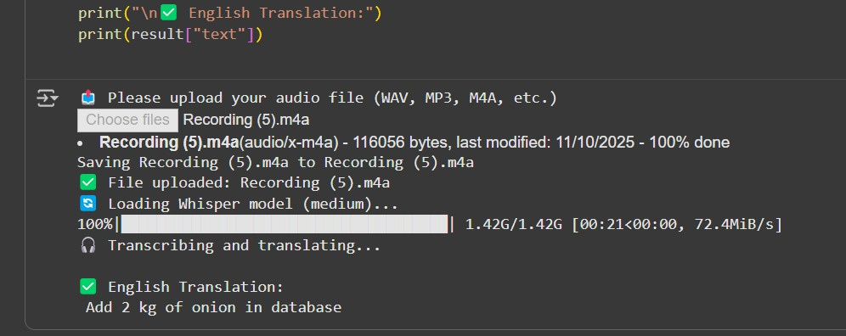
04
THE PROTOTYPE
INITIAL SOLUTION
1

Slide 6
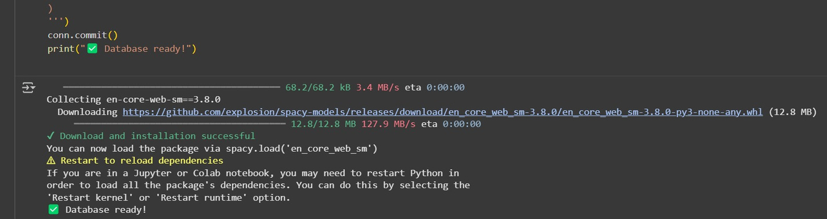
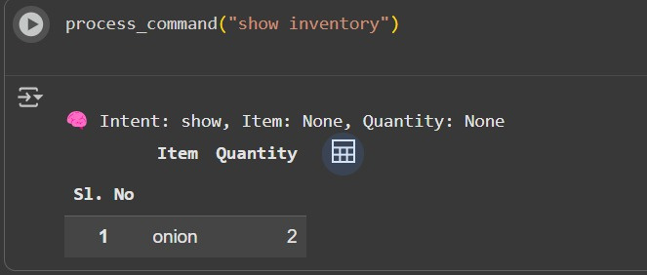

05
THE PROTOTYPE
INITIAL SOLUTION
2
3
4

Slide 7
06
TECH STACK
Front-end: Streamlit
Database: SQL Lite
Speech-to-Text: OpenAI Whisper
Natural Language to SQL: Ollama (LLaMA 3.2 3B)
Utility Libraries: Pandas
Frameworks: Langchain

Slide 8
07
SYSTEM ARCHITECTURE
Input: User provides a command via:
A) Audio Upload (MP3, WAV, OPUS, M4A)
B) Text Input
Transcription (if audio): The audio file is sent to the Whisper model. Whisper transcribes it and outputs a plain text string (e.g., "remove 5 carrots").
NL-to-SQL:
The text command is combined with a special "prompt" that explains the database table and its columns.
This full prompt is sent to the Ollama (LLaMA 3.2) model.
LLaMA generates the corresponding SQL query (e.g., UPDATE Inventory SET quantity = quantity - 5 WHERE item_name = 'Carrot';).
Execution & Update:
The generated SQL query is executed on the SQLite database.
The inventory table is updated.
Feedback (UI): The Streamlit app automatically refreshes to display the newly updated inventory list to the user.
Input
Audio/Text
Transcription
Prompt
NLP
LLM model
Query
Database Update

Slide 9
08
CORE FEAUTURES
Natural Language Understanding:
Automatic Speech-to-Text Conversion:
Intelligent Query Generation:
.
The system can interpret everyday human speech or text, converting it into structured information. It understands intent rather than just words.
Using OpenAI’s Whisper model, spoken commands are accurately transcribed into text that the LLM can understand.
The LLM (Llama 3 or GPT-like model) converts natural language instructions into SQL queries or structured commands suitable for databases.
Error Handling & Context Awareness:
Dynamic Database Interaction:
Streamlit Interface Integration:
The system detects invalid or ambiguous queries and uses the LLM’s reasoning ability to refine or correct them automatically
The generated SQL queries are executed directly on a live database, allowing real-time data manipulation and feedback.
The entire system runs in a user-friendly Streamlit app, integrating audio recording, transcription, LLM reasoning, and database visualization seamlessly.

Slide 10
09
SPEECH RECOGNITION (WHISPER)
Whisper is an open-source Automatic Speech Recognition (ASR) model developed by OpenAI.
It converts human speech into text by analyzing the audio signal and predicting the most likely sequence of words.
Its ability to handle different accents, background noise, and languages makes it highly reliable for real-world applications.
Key Features:
Utilizes a Transformer-based encoder-decoder architecture for accurate transcription.
Trained on multilingual and multitask datasets, ensuring wide language coverage.
Robust to noise, accents, and variations in speech.
Supports real-time transcription — ideal for projects that involve voice commands.
Different model sizes (tiny, base, small, medium) let you balance speed vs accuracy based on system resources.

Slide 11
10
ROLE OF LLM IN INVENTORY MANAGEMENT
The Large Language Model (LLM) — such as Llama 3, Mistral, or acts as the brain of the system.
It interprets the user’s natural language commands, understands their intent, and converts them into structured SQL queries that the database can execute.
This bridges the gap between human language and machine-readable instructions.
Key Functions:
Understands user intent through semantic reasoning and context interpretation.
Translates phrases like “remove two tomatoes” → UPDATE Inventory SET quantity = quantity - 2 WHERE item_name='Tomato';
Uses prompt engineering to control behavior, ensuring SQL syntax accuracy and relevance.
LangChain helps organize this process using components like LLMChain, managing input prompts and model outputs.
Enables natural, conversational inventory control without needing SQL knowledge.

Slide 12
11
LANGCHAIN FRAMEWORK
LangChain serves as the bridge between the LLM, the application logic, and the database.
It structures the flow of information — from user input to intelligent reasoning — ensuring the model behaves consistently and contextually.
LangChain enables us to build modular, memory-aware, and scalable AI applications.
Core Features:
Prompt Templates – Define how the system communicates with the LLM, ensuring clarity and consistency.
Chains – Create logical sequences of tasks (e.g., speech → text → SQL query → database update).
Memory – Retains context across multiple user queries, enabling follow-up commands like “Now remove two tomatoes”.
Integration Support – Easily connects models like LLaMA, GPT-J, or Mistral with tools, APIs, and databases.

Slide 13
12
PROMPT ENGINEERING
The prompt serves as the guiding instruction for the Large Language Model (LLM).
It defines the context, structure, and behavior the model should follow when generating responses.
In our system, the prompt ensures that the model understands how to correctly interpret user commands and convert them into valid SQL queries.
Key Functions of the Prompt:
Provides the database schema and column names to help the model understand the structure.
Specifies how to handle add, remove, and update operations accurately.
Enforces the use of proper SQL syntax and prevents irrelevant or conversational outputs.
Acts as a rulebook that guides the LLM’s reasoning, ensuring consistent and reliable query generation.

Slide 14
13
QUERY GENERATION & CORRECTION
After the LLM generates an SQL query, the output is parsed and refined using Python and Regular Expressions (Regex).
This step ensures that the SQL statements follow correct syntax, handle edge cases, and safely update existing records instead of creating duplicates.
By automatically modifying INSERT queries into UPSERT operations, the system maintains accurate and consistent inventory data.
Core Processing Steps:
Parsing & Cleaning: The LLM’s raw text output is processed using Python string operations and Regex to remove formatting issues.
UPSERT Logic: Prevents duplicate entries by updating quantities when an item already exists.
Data Integrity: Ensures the database remains consistent even when similar commands are repeated.
INSERT INTO Inventory (item_name, quantity)
VALUES ('Apple', 2)
ON CONFLICT(item_name)
DO UPDATE SET quantity = quantity + 2;
Ensures data integrity and error-free execution.

Slide 15
14
DATABASE INTEGRATION
The system takes the SQL query produced by the LLM and runs it on a SQLite database.
This step bridges the gap between human intent and machine action, ensuring that every instruction—typed or spoken—results in an actual change in the inventory.
Key Points:
Executes SQL queries (INSERT, UPDATE, SELECT, DELETE) dynamically.
Reflects real-time updates in the displayed inventory table.
Converts natural language into actionable database commands.
Ensures smooth, end-to-end flow from input → query → result.
Example:
“Add 5 Apples” → UPDATE Inventory SET quantity = quantity + 5 WHERE item_name='Apple';

Slide 16
15
STREAMLIT FRONTEND
Streamlit serves as the interactive user interface that connects all components — audio input, transcription, LLM interpretation, and database updates — into one seamless dashboard.
It allows users to interact with the system in real time without needing any backend setup or web development.
Key Points:
Enables uploading or recording of voice commands.
Displays transcribed text and generated SQL queries instantly.
Visualizes database updates in a clean, tabular format.
Provides an intuitive, single-page workflow: Record → Transcribe → Interpret → Execute → Display.

Slide 17
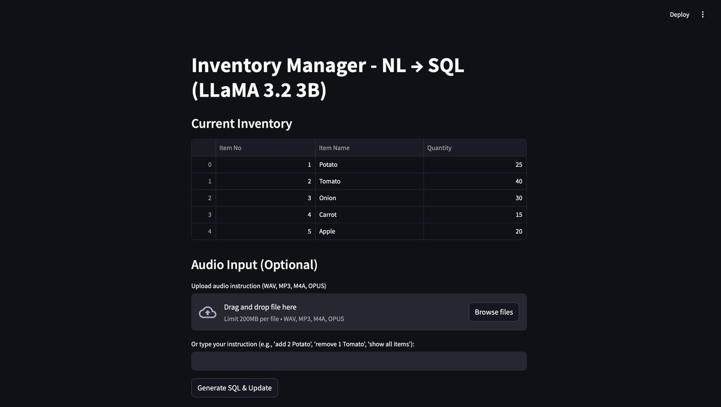
LIVE DEMO
AUDIO (OR) TEXT INPUT

Slide 18
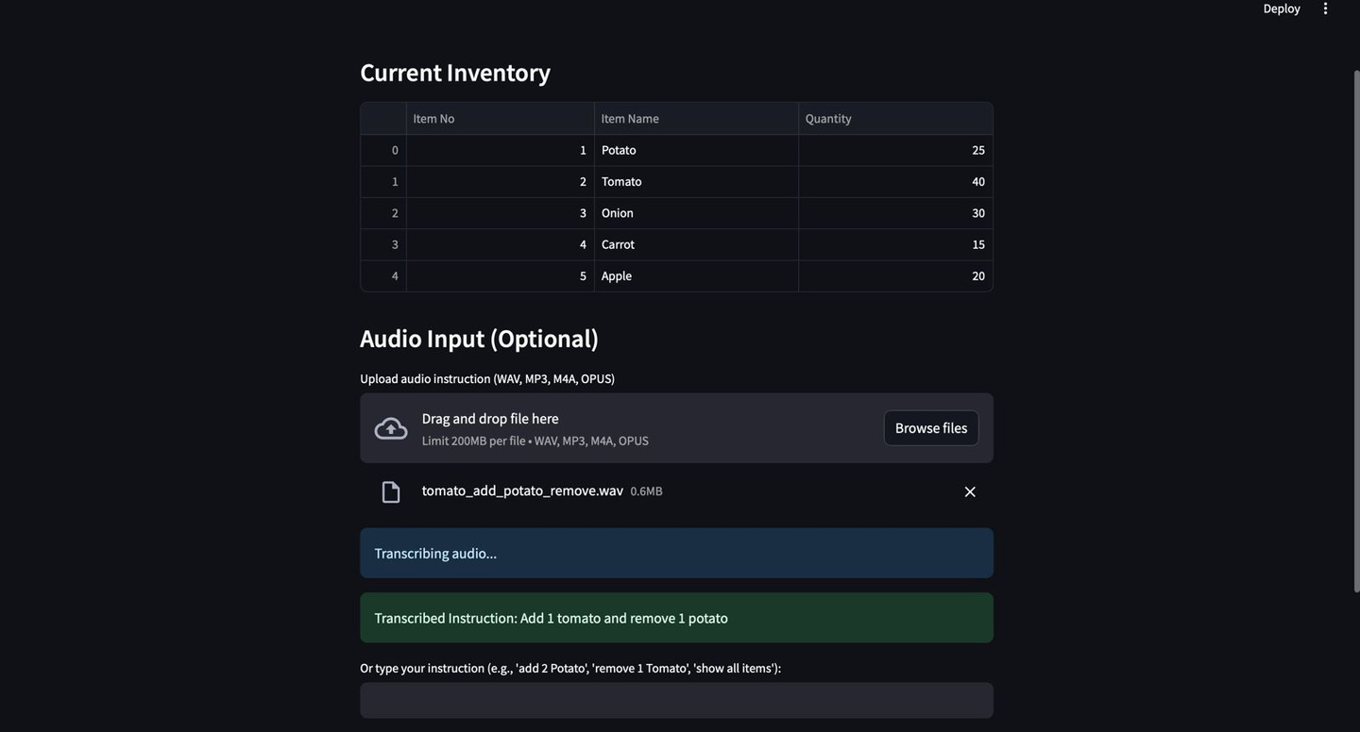
LIVE DEMO
TRANSCRIPTION → SQL QUERY → DATABASE UPDATE

Slide 19
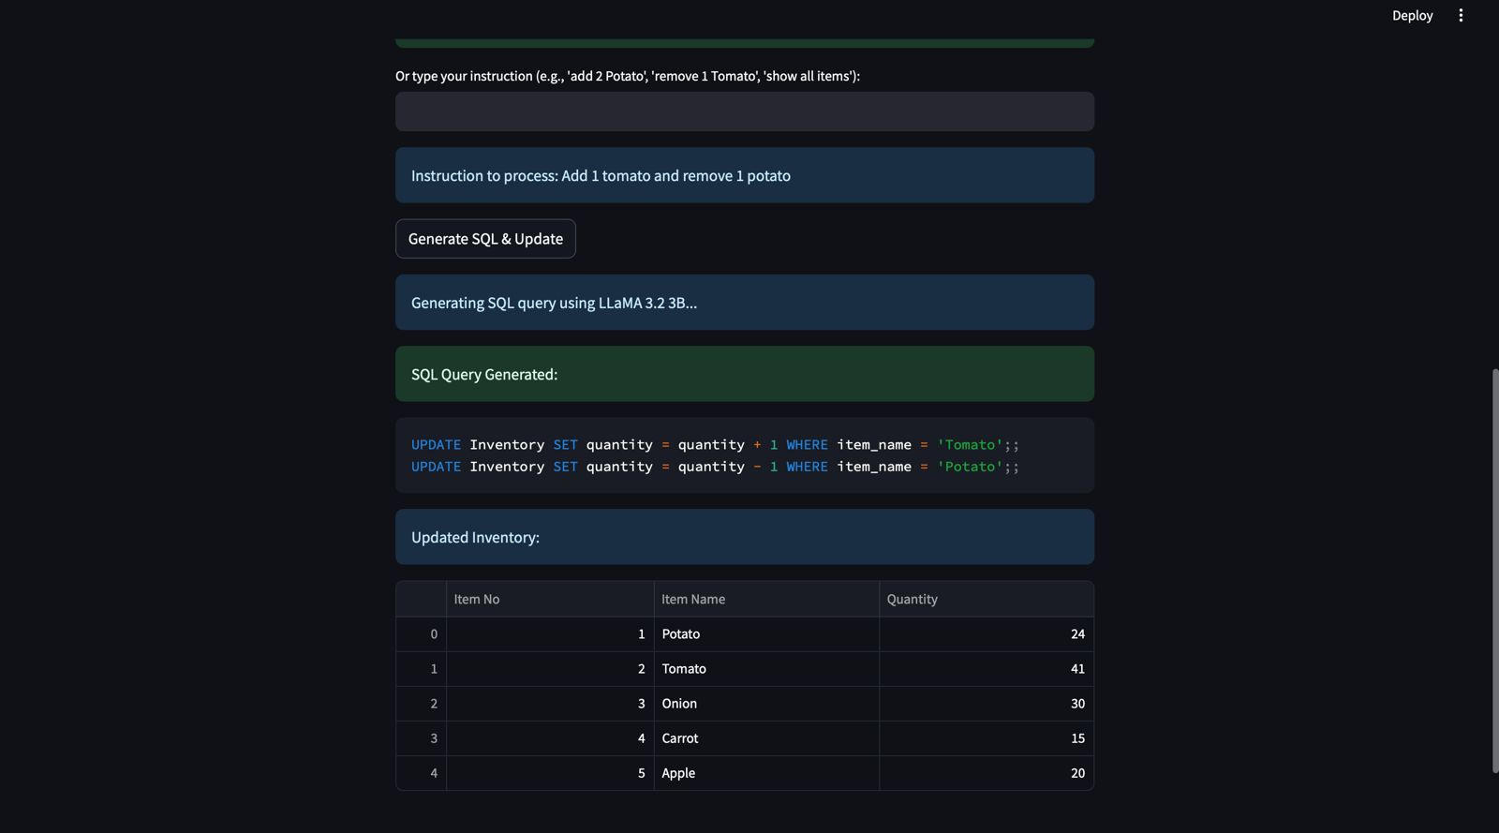
LIVE DEMO
UPDATED DATABASE

